Slide 1
CASE STUDY 2
Southern Ontario Operations
Generesta
Engineering
Consulting
Key Workforce Facts
3,217
73.8%
Total Employees
Male Workforce
21.1%
529
Workforce Demographic
& Turnover Analysis
Engineers
Retirements (4 yrs)
Prepared by:
Group 4
Khang Nguyen · Yue Dong Pan · Mitchell Opeshansky

Slide 2
Presentation Overview
01
Company Overview
05
Leave of Absence
Who is Generesta? Data sources & scope
Gender & reason code analysis
02
Occupation Distribution
06
Retirement Trends
Role breakdown & gender by occupation
4-year review & knowledge risk
03
Workforce Demographics
07
Recommendations
Gender, age, and employment status
Six strategic priorities for leadership
04
Turnover Analysis
Voluntary vs. involuntary, 2007–2010
Generesta Engineering Consulting | Workforce Analysis | Group 4

Slide 3
Company Overview
About Generesta
Data Source 1
Mid-sized engineering & technical consulting firm
Headquartered in Southern Ontario, Canada
~3,217 active employees across all functions
Serves 4 key sectors of the Canadian economy
Operations extend into select northern U.S. states
Workforce spans C-suite to trades and admin staff
Payroll Database Master
Active employees: occupation,
gender, age, employment status
Data Source 2
Terminated Employee Database
Historical separations: category,
reason, and year of termination
Generesta Engineering Consulting | Workforce Analysis | Group 4

Slide 4
01
Occupation Distribution
& Gender Breakdown
Who works at Generesta - and how is representation distributed?

Slide 5
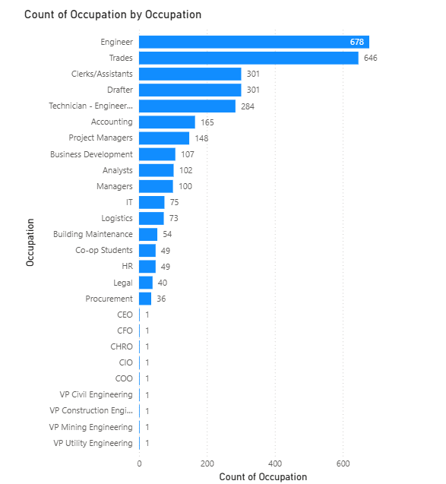
Occupation Distribution — All Employees
678
Engineers
(21.1%)
646
Trades
(20.1%)
301
Drafters
301
Clerks/Assist.
Engineers + Trades = 40%+ of headcount
Generesta Engineering Consulting | Workforce Analysis | Group 4

Slide 6
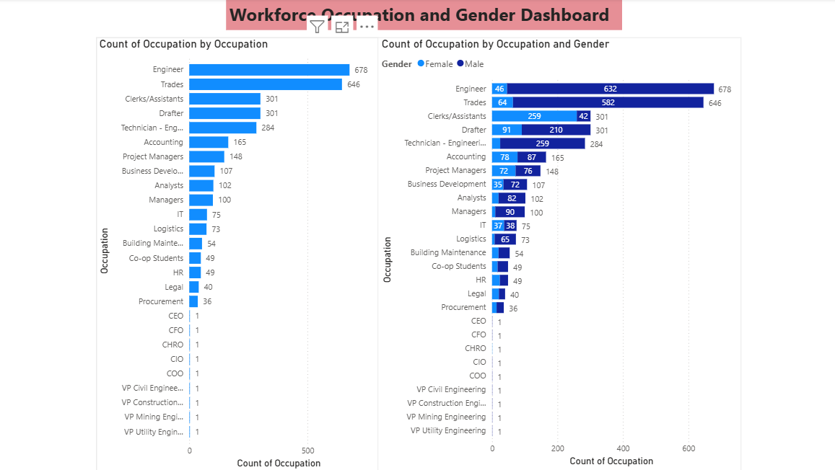
Occupation by Gender - Key Findings
14:1
9:1
~1:6
Male-to-Female ratio in Engineering
Male-to-Female ratio in Trades
Male-to-Female ratio in Clerks/Assistants
Generesta Engineering Consulting | Workforce Analysis | Group 4

Slide 7
02
Workforce Demographics
Gender, age distribution, and employment status

Slide 8
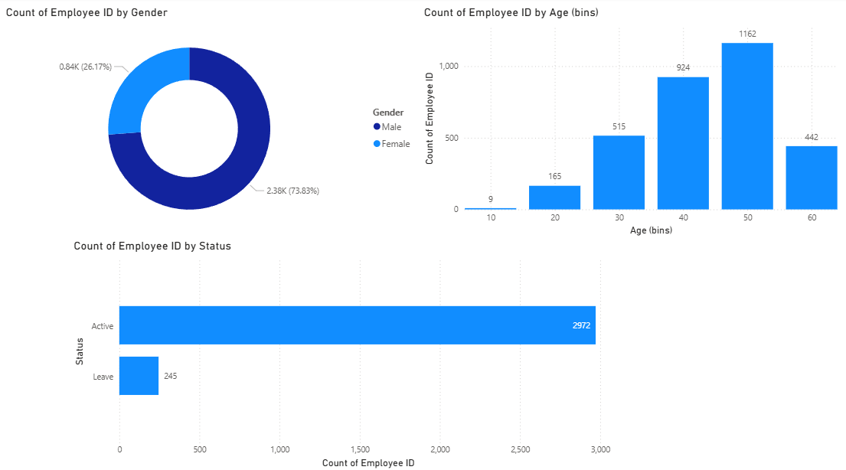
Workforce Demographics - Combined Dashboard
73.8% Male
Age Peak: 40–49
92.4% Active
26.2% Female
65% aged 40–59
7.6% on Leave
Generesta Engineering Consulting | Workforce Analysis | Group 4

Slide 9
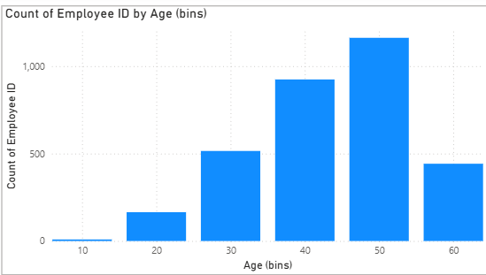
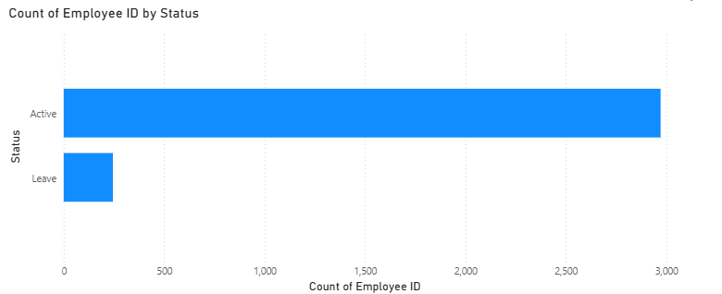
Age Distribution & Employment Status
Age Distribution
Employment Status
Key Insight:
65% of employees fall in the 40–59 age bracket — creating an imminent succession risk as this cohort approaches retirement age over the next decade.
Generesta Engineering Consulting | Workforce Analysis | Group 4

Slide 10
03
Turnover Analysis
Voluntary vs. Involuntary separations - 2007 to 2010

Slide 11
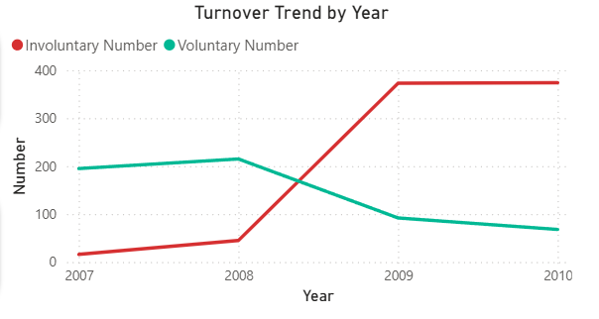
Voluntary vs. Involuntary Turnover (2007–2010)
Year | Vol. % | Invol. %
2007 | 92.4% | 7.6%
2008 | 82.7% | 17.3%
2009 | 19.8% | 80.2%
2010 | 15.4% | 84.6%
The 2008 Financial Crisis
Involuntary turnover surged from 17.3% in 2008 to 80.2% in 2009 — a direct consequence of large-scale layoffs during the economic downturn.
Generesta Engineering Consulting | Workforce Analysis | Group 4

Slide 12
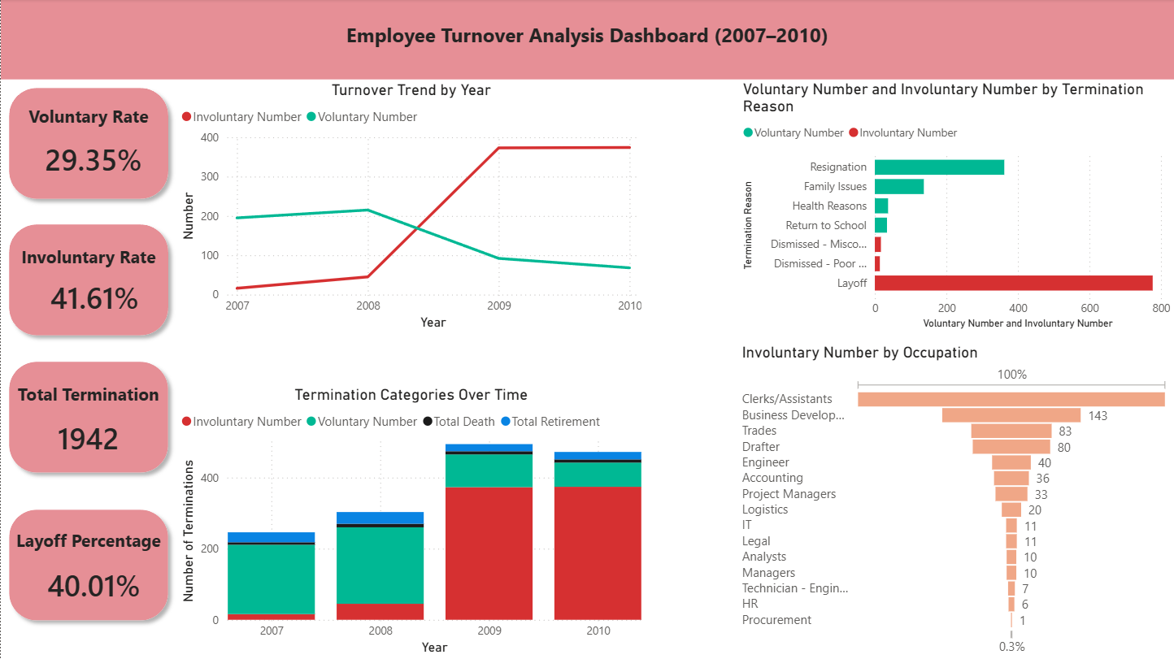
Top Termination Reasons - All Years Combined
#1
777
Layoff
#2
427
Early Retirement
#3
362
Resignation
#4
137
Family Issues
Total separations: 1,942
Generesta Engineering Consulting | Workforce Analysis | Group 4

Slide 13
04
Leave of Absence
Demographic analysis by gender and reason code

Slide 14
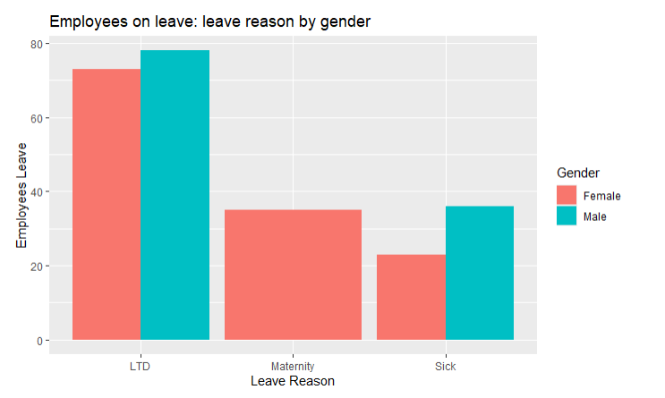
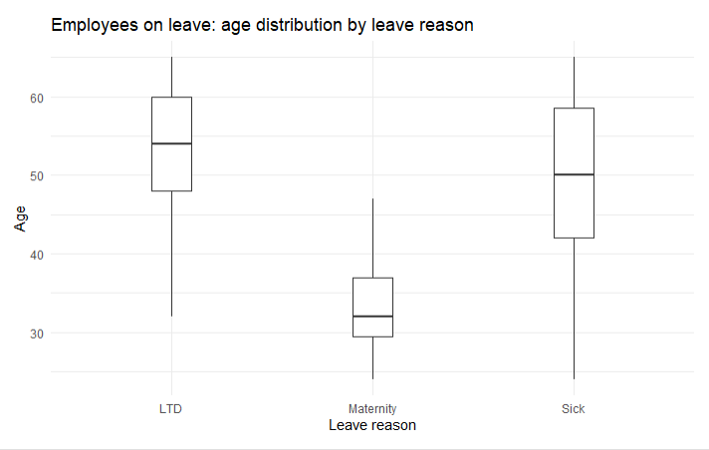
Leave of Absence - Gender & Reason Breakdown
Gender vs. LOA Share
Reason Code Breakdown
Women are 26.2% of the workforce but 53.5% of LOA cases. LTD alone accounts for 61.6% of all leaves — pointing to occupational health risks in trades & engineering roles.
Generesta Engineering Consulting | Workforce Analysis | Group 4

Slide 15
05
Retirement Trends
A 4-year review of early and standard retirements

Slide 16
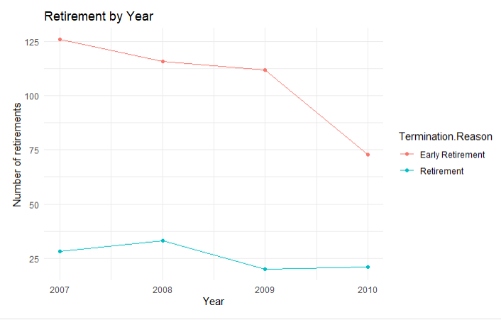
Retirement Analysis - Last 4 Years
529
Total Retirements
(4-year period)
80.7%
Early Retirement
Share
~30 yrs
Average Tenure
at Retirement
80.7% early retirement rate — likely tied to incentive programs during the 2009–2010 restructuring. Retiring employees carry ~30 years of institutional knowledge, creating a significant succession risk.
Generesta Engineering Consulting | Workforce Analysis | Group 4

Slide 17
06
Recommendations
Six strategic priorities for Generesta's leadership

Slide 18
Recommendations — Part 1 of 2
R1
Gender Diversity in Technical Roles
Partner with Ontario universities for STEM co-op pipelines
Review job postings for inclusive language
Set 3–5 year gender diversity hiring targets
R2
Succession & Knowledge Transfer
Map internal successors for top 100–150 retirement-risk roles
Create knowledge-capture and mentoring pair programs
Introduce phased retirement arrangements
R3
Address LTD & Workplace Health
Ergonomics review across trades & field operations
Invest in EAP, physiotherapy, and early return-to-work
Track LTD cases by department to find high-risk areas
Generesta Engineering Consulting | Workforce Analysis | Group 4

Slide 19
Recommendations — Part 2 of 2
R4
Strengthen Retention for Voluntary Turnover
Conduct structured exit interviews to identify root causes
Benchmark total compensation annually vs. market rates
Develop visible career ladders for technical staff
R5
Return-to-Work Support for Leave Employees
Formalize flexible scheduling for LTD and parental returnees
Train managers on Ontario accommodation & HR legislation
Assign dedicated HR partners to employees on extended leave
R6
Institutionalize Workforce Analytics
Deploy Power BI / Tableau connected to live HR systems
Establish quarterly executive HR dashboard
Build predictive retirement & attrition models
Generesta Engineering Consulting | Workforce Analysis | Group 4

Slide 20
Conclusion
Technically-led workforce
Recession left a lasting mark
Engineering + Trades represent 41% of headcount; the firm's core strength is its technical depth.
Involuntary turnover hit 84.6% in 2010. Retention strategies are critical as the market recovers.
Gender gaps require action
Health absences are high
14:1 male/female in Engineering; structural gaps need targeted recruitment and policy changes.
61.6% of LOA cases are LTD - occupational health investment will reduce long-term costs.
Aging workforce is a priority
Early retirement drains knowledge
65% of employees aged 40–59 - succession planning is an immediate need, not a future one.
80.7% early exit rate means institutional expertise is leaving faster than expected.
Prepared by Group 4: Khang Nguyen · Yue Dong Pan · Mitchell Opeshansky

